Slide 1

Feature Extraction and Price Prediction for Mobile Phones project-4
Pradeep Kumar Chauhan

Slide 2
Introduction
In this project, we will work with a dataset that contains detailed information about various mobile phones, including their model, colour, memory, RAM, battery capacity, rear camera specifications, front camera specifications, presence of AI lens, mobile height, processor, and, most importantly, the price. We will develop a predictive model for mobile phone prices.

Slide 3
Feature Extraction
Feature extraction is the process of transforming raw data into a set of measurable features (also called attributes or variables) that can be used to train a machine learning model. It is crucial for improving the performance of models, especially when the dataset is complex or unstructured (like text, images, or audio).

Slide 4
Prediction
Once you've extracted features, the next step is prediction, where a machine learning model is trained on the extracted features to predict outcomes on unseen data.
For example, after you extract features (from text, images, or structured data), you can use those features to predict a target variable like price.

Slide 5
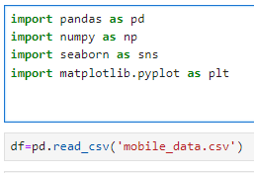
Step by step process
# importing important libraries and Reading the data files

Slide 6
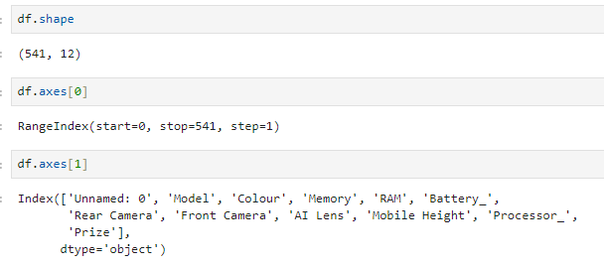
# finding different attributes of the data to know insight

Slide 7
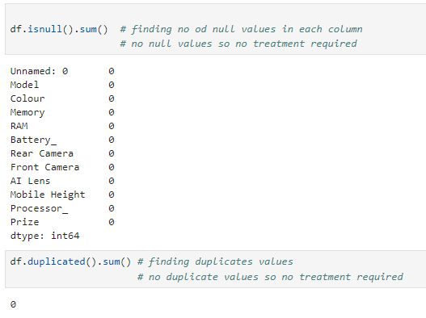
Finding null values and duplicate values

Slide 8
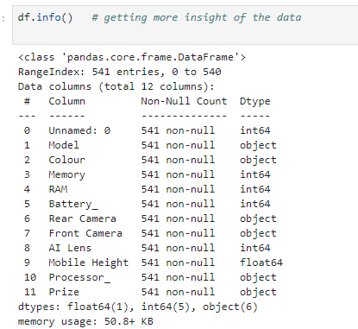
Getting more info of the data

Slide 9
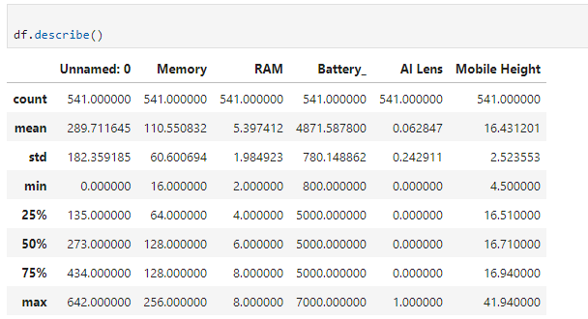
Getting further insights by knowing statistically important data

Slide 10
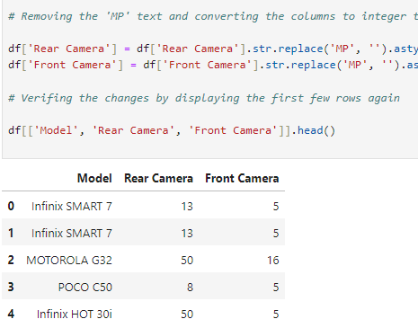
Treating the columns so that their data can be utilize by converting string to int.

Slide 11
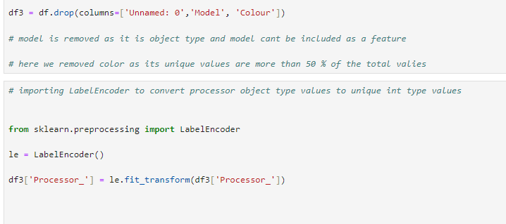
Dropping unnecessary columns

Slide 12
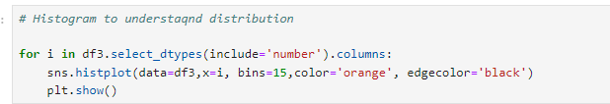
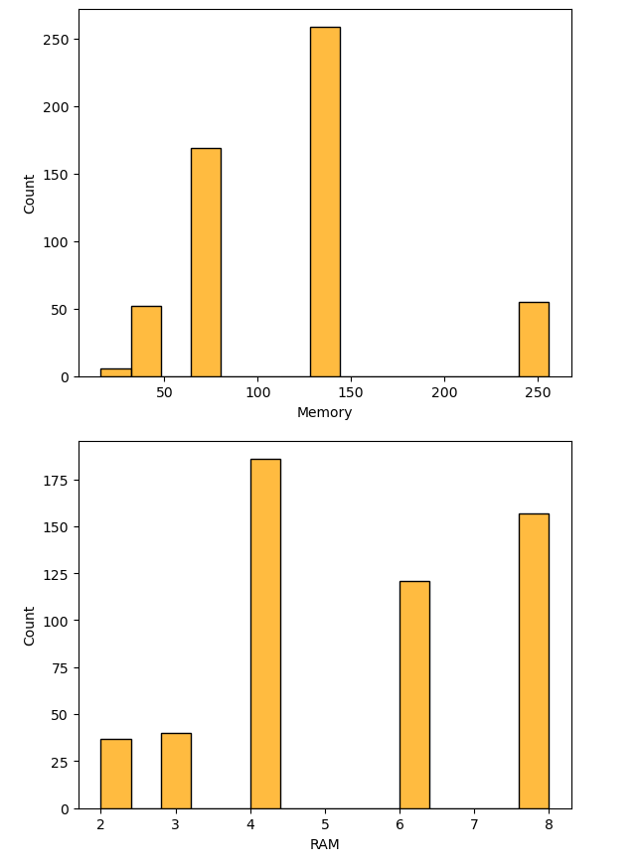
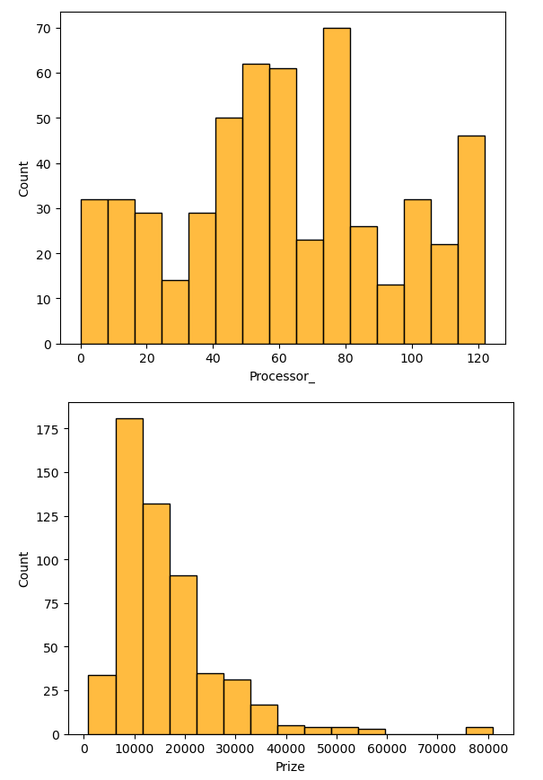
Plotting histogram

Slide 13
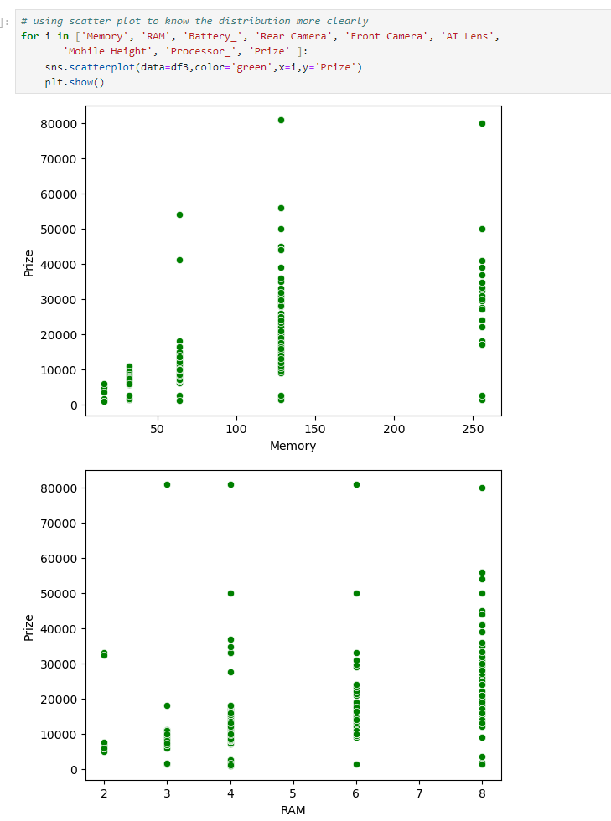
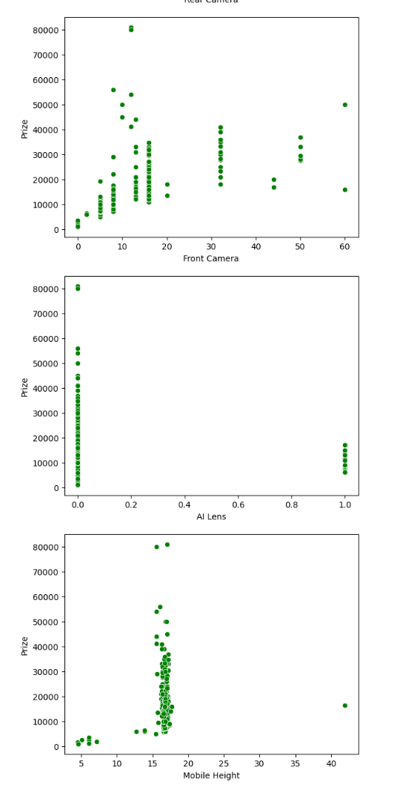
Plotting scatter plot

Slide 14
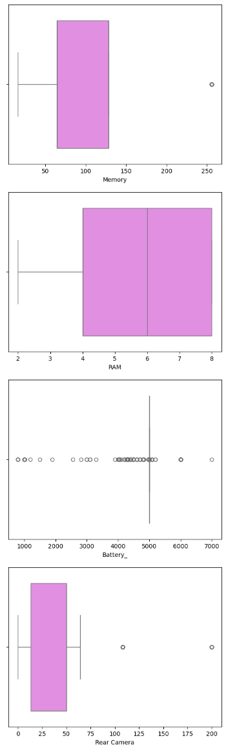
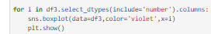
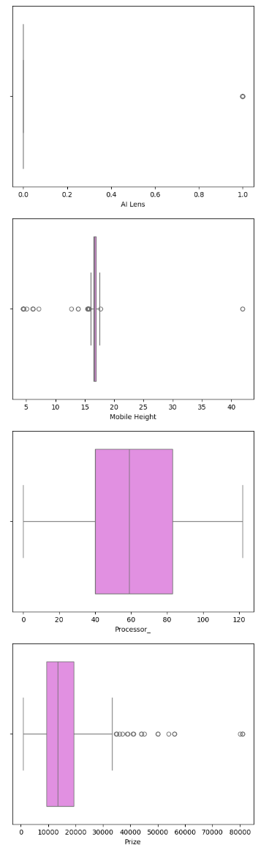
Box plot to identify outliers

Slide 15
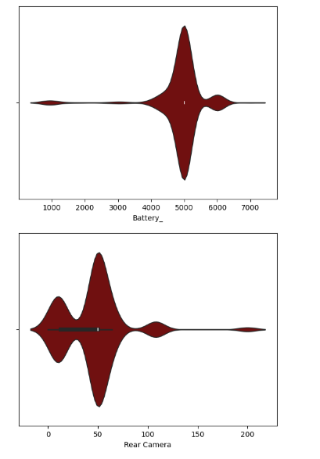
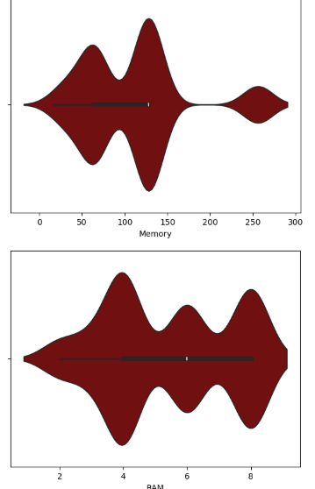
Violin plots

Slide 16
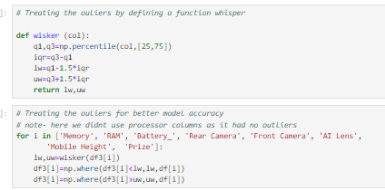
Treating the outliers

Slide 17
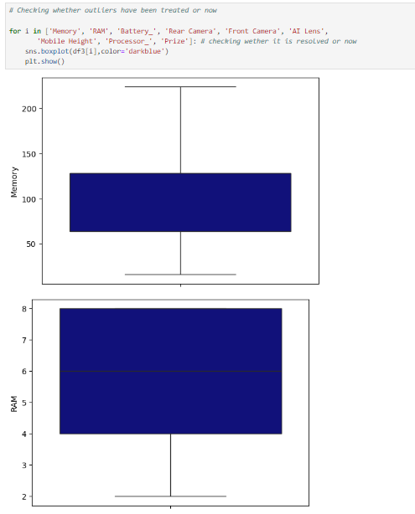
Box plot to recheck

Slide 18
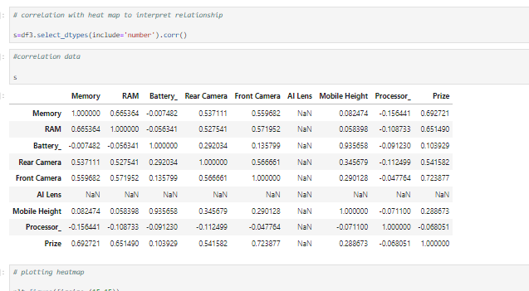
correlation

Slide 19
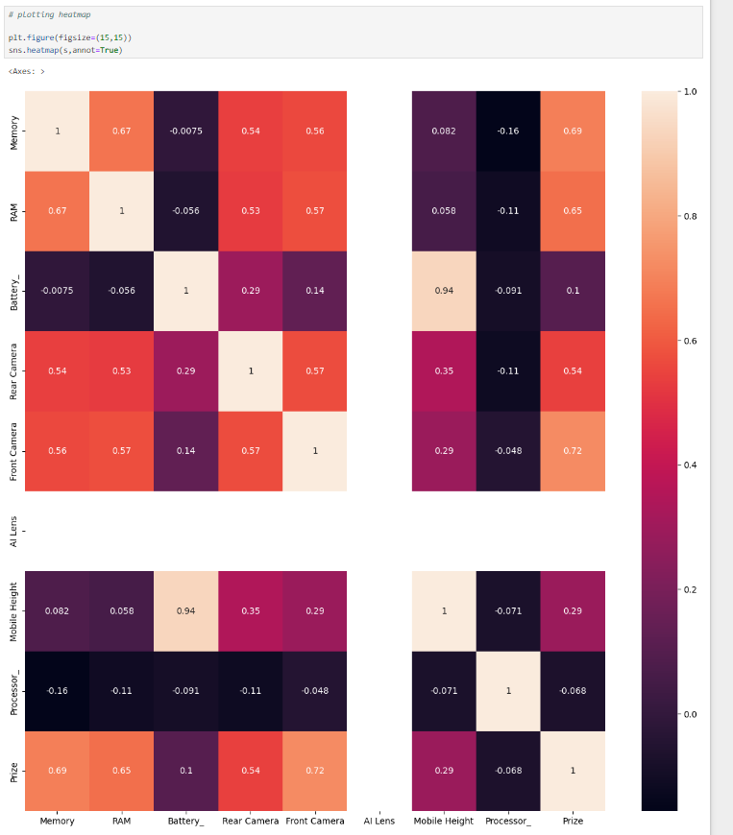
Heatmap

Slide 20
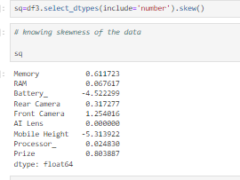
Skewness

Slide 21
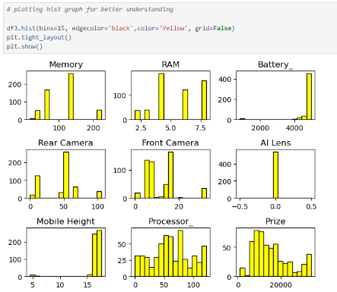
Plotting histogram

Slide 22
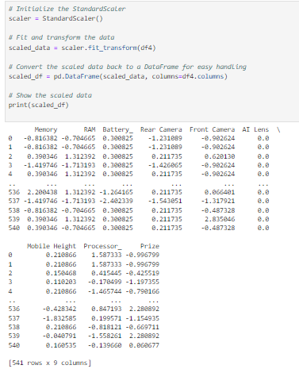
Scaling data using standard scaling

Slide 23
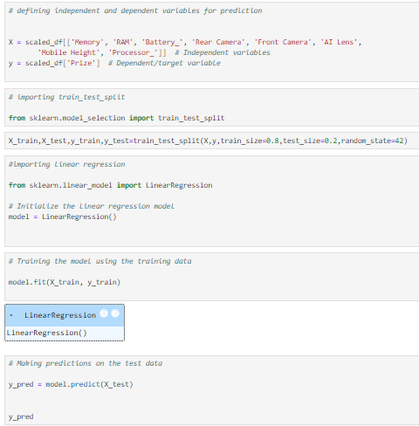
Defining training and testing sets

Slide 24
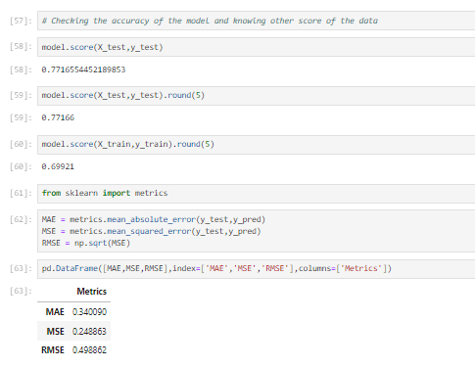
Checking accuracy

Slide 25
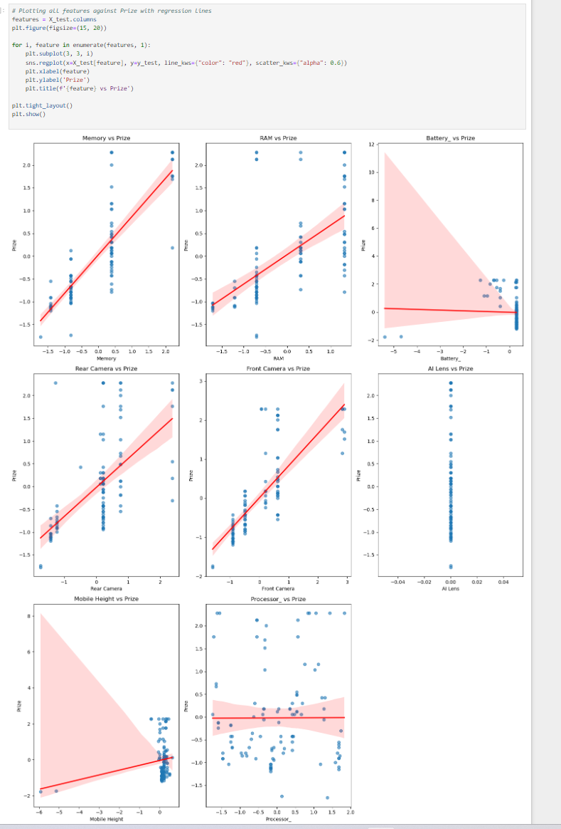
Plotting linear regression with different independent variable/

Slide 26
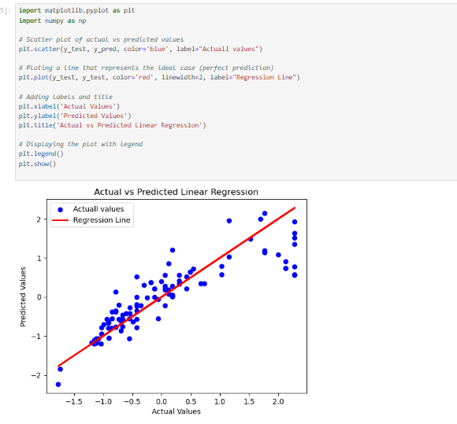
Finally plotting actual vs predicted regression line

Slide 27
Thank you

